Slide 1
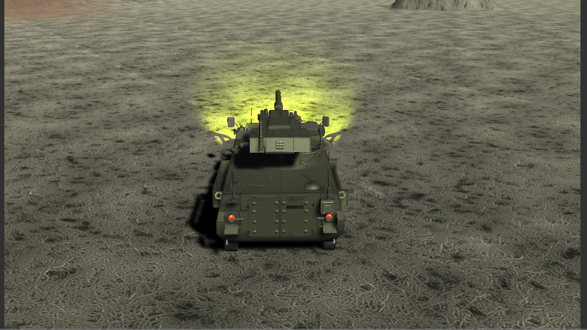
Game Graphics Assignment 3
Mark Kyle
James McGowan

Slide 2
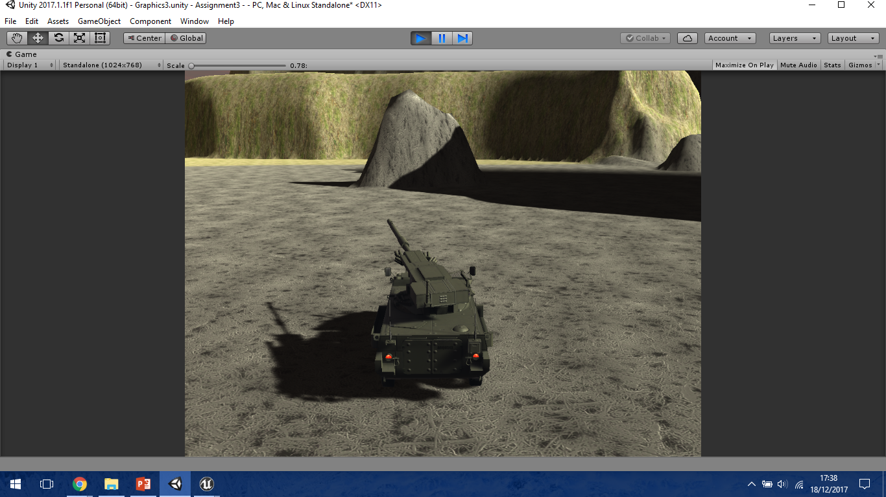
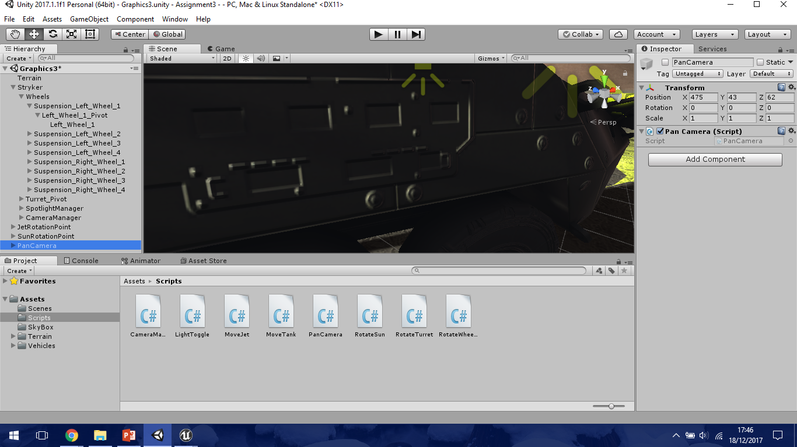
Stryker (Vehicle)
Controlled using arrow keys
Uses “MoveTank” script
Stryker hierarchy
Wheels (Collider for each wheel, travelling the terrain more realistic)
8 Wheels = 8 Colliders
Uses “RotateWheels” script

Slide 3
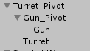
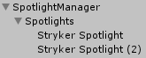
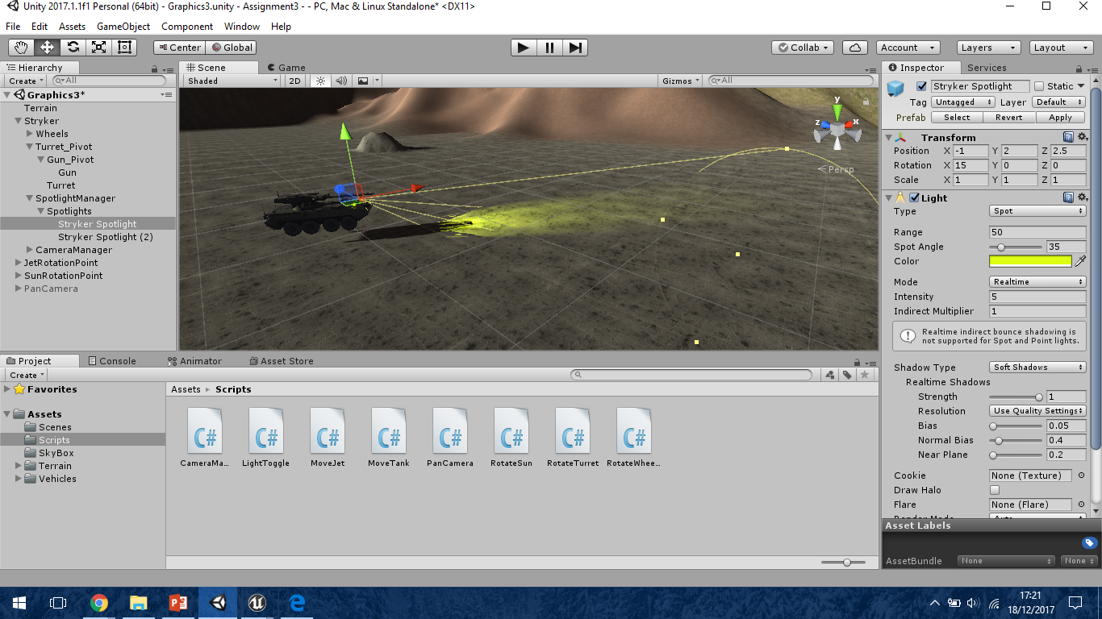
Stryker (Vehicle)
“Gun” & “Turret” are the two parts that make up the Stryker’s Weapon
Controlled using WASD
The same script is attached to both elements.
“RotateTurret”
SpotlightManager contains the headlights for the Stryker.
Two spotlights attached to the front of the vehicle.
Uses “LightToggle” script
Ability to toggle headlights on/off. (N)

Slide 4
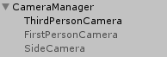
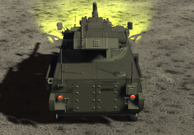
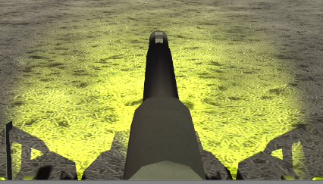
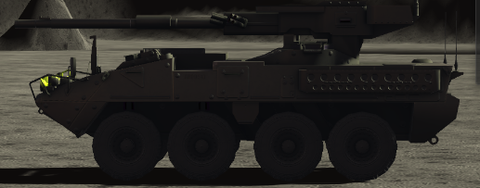
Stryker (Vehicle)
Three camera modes.
Third Person Camera (1)
First Person Camera (2)
Side Camera (3)
Implemented to show the wheels rotation.
Since we have a lot of cameras for multiple aspects, we decided to create a camera manager that contains the code for switching between cameras, with a single script attached to the manager.

Slide 5
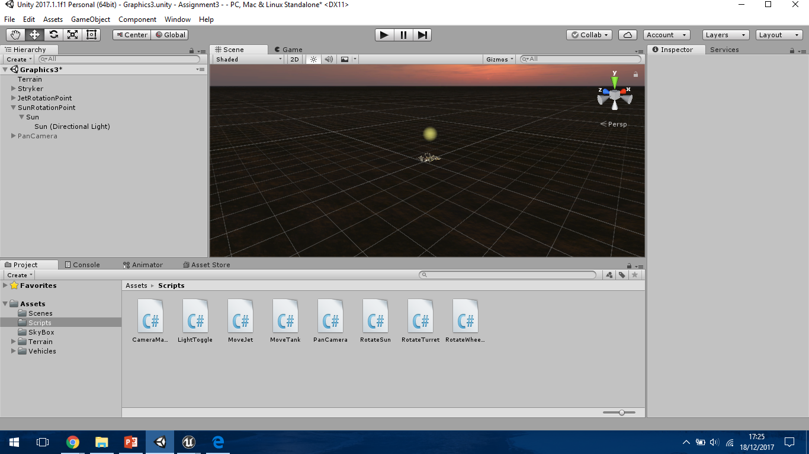
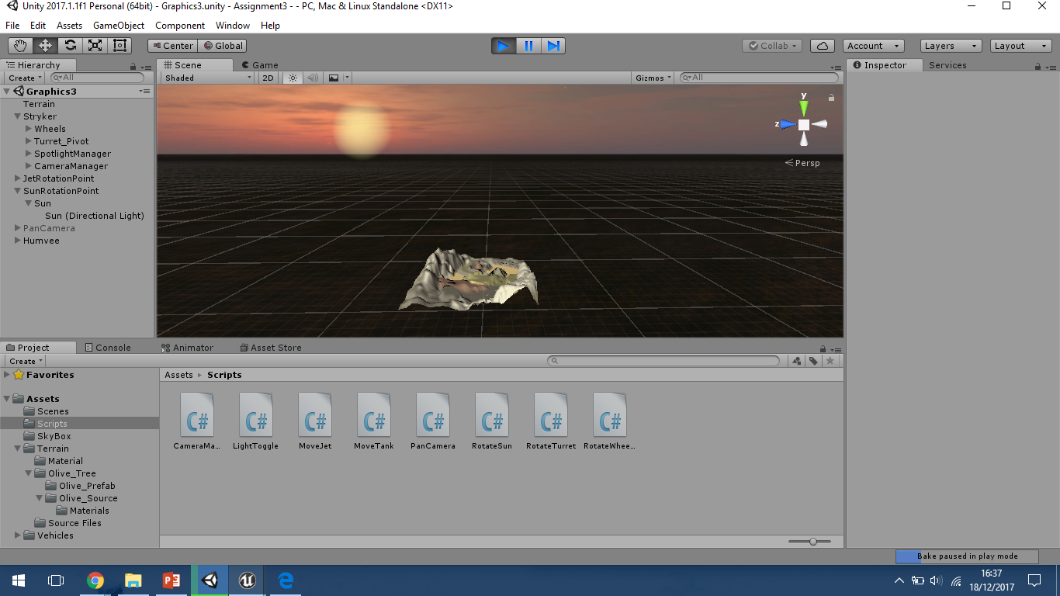
Sun
Directional light
Creates a day/night cycle
Rotates around terrain using a central rotation point
Uses “RotateSun” script

Slide 6
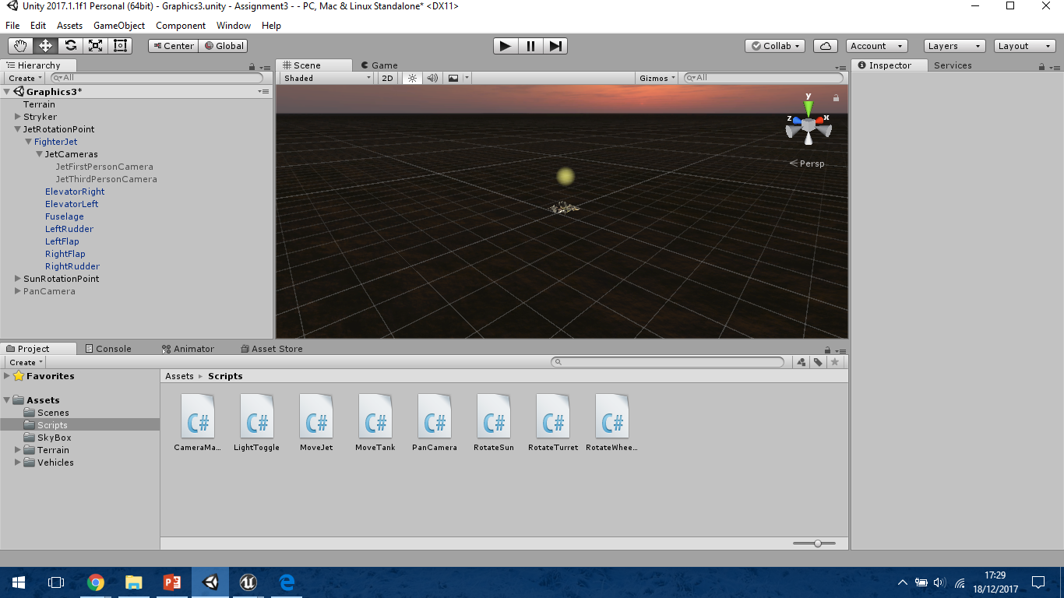
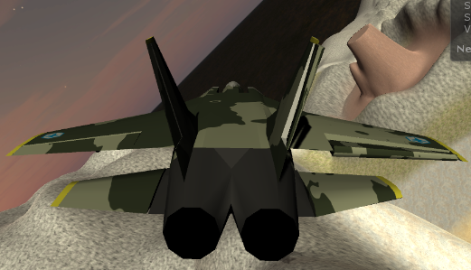
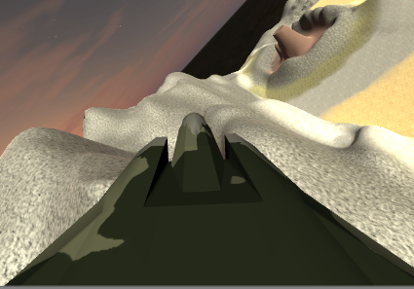
Fighter Jet
Constantly Moving Element within the scene.
Two camera modes
First Person (9)
Third Person (0)
Rotation point within the scene that the jet will always be flying around.
Uses “MoveJet” script

Slide 7
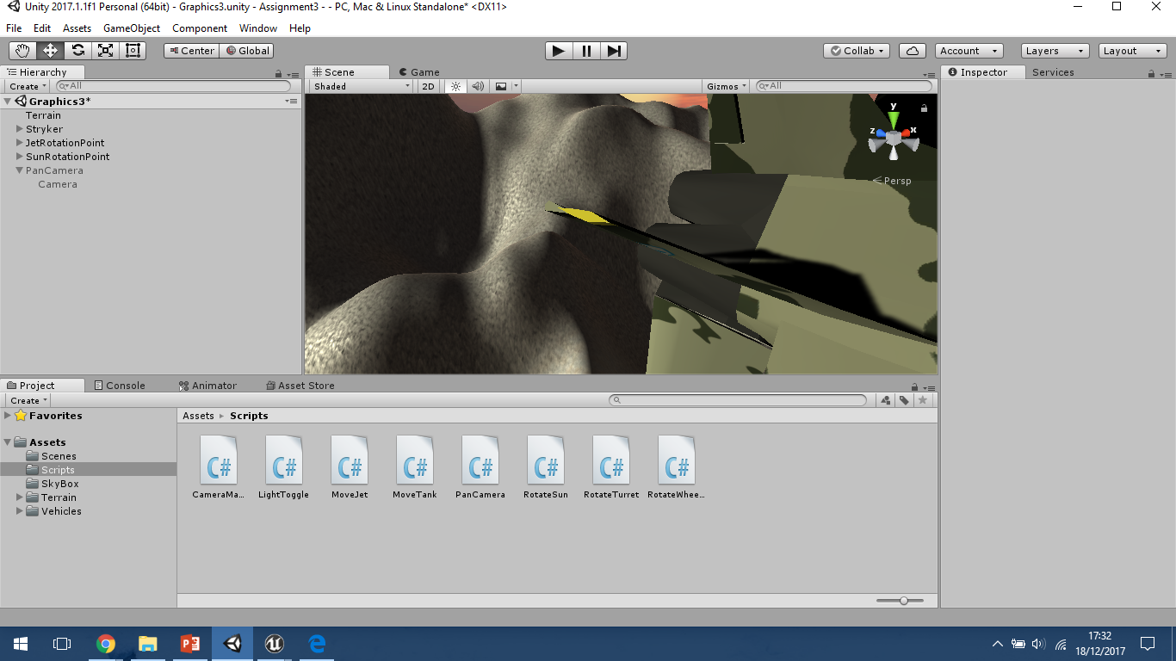
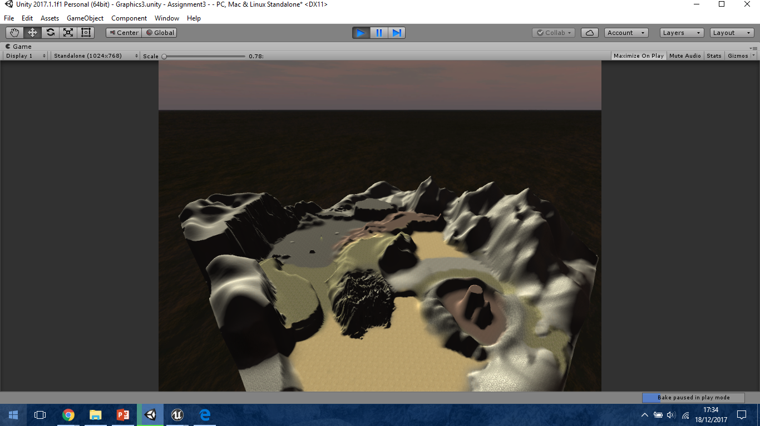
Panning Camera
This is a camera that is constantly moving and showing the entire scene. (4)
Uses “PanCamera” script

Slide 8
DEMO

